Slide 1

Project 3: Using Machine Learning to Explore and Predict Heart Failure
Ankita Puri
Kritika Chaudhary
Wei (Will) Ke
James Rydlewski
Joshua Borschman

Slide 2
A problem worth analysing
110,000 (0.5%) people live with heart failure.
Almost twice as many men experience heart failure compared to women.
Heart failure accounts for almost one in 50 deaths, equating to one person dying of heart failure every three hours, or eight deaths each day being due to heart failure.
Deaths from heart failure have been decreasing over time, with more females dying of heart failure than males.
179 people are hospitalised due to heart failure per day, equating to one person every eight minutes.
Hospitalisations due to heart failure have remained relatively steady over the last decade, with similar number of males and females being admitted to hospital for heart failure.
https://www.heartfoundation.org.au/activities-finding-or-opinion/key-statistics-heart-failure

Slide 3
Data explanation
Age : Age of patient
Anaemia : Decrease of red blood cells or hemoglobin (boolean)
Creatinine_phosphokinase : Level of the CPK enzyme in the blood (mcg/L)
Diabetes : If the patient has diabetes (boolean)
Ejection_fraction : Percentage of blood leaving the heart at each contraction (percentage)
high_blood_pressure :of the patient has hypertension (boolean)
Platelets :Platelets in the blood (kiloplatelets/mL)
Serum_creatinine :Level of serum creatinine in the blood (mg/dL)
Serum_sodium :Level of serum sodium in the blood (mEq/L)
Sex :Woman or man (binary)

Slide 4
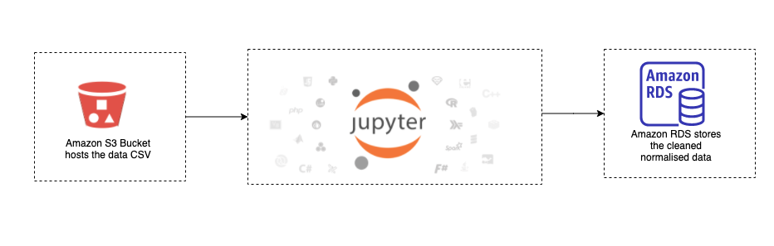
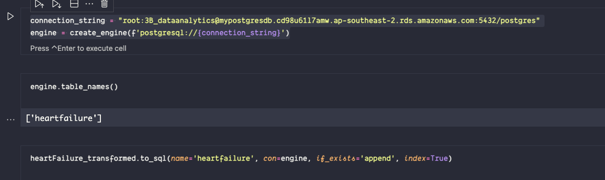
ETL

Slide 5
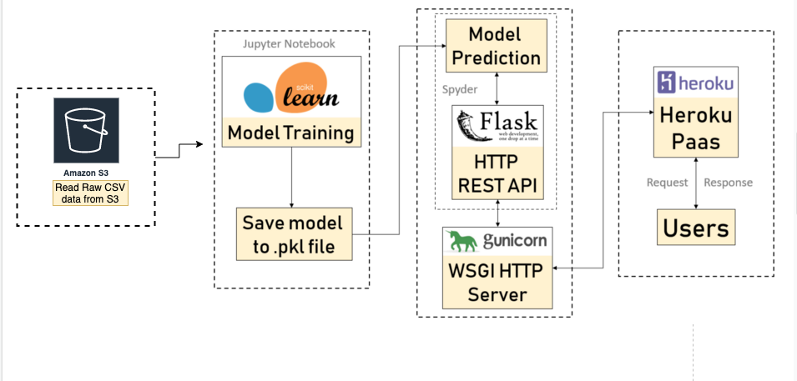
Machine Learning Architecture

Slide 6
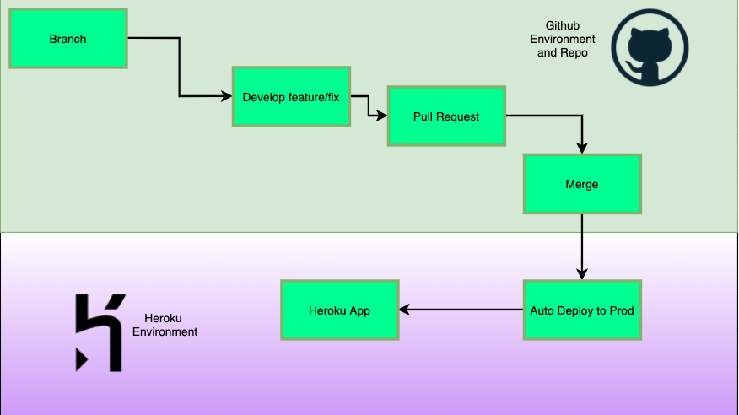
Deployment Process

Slide 7

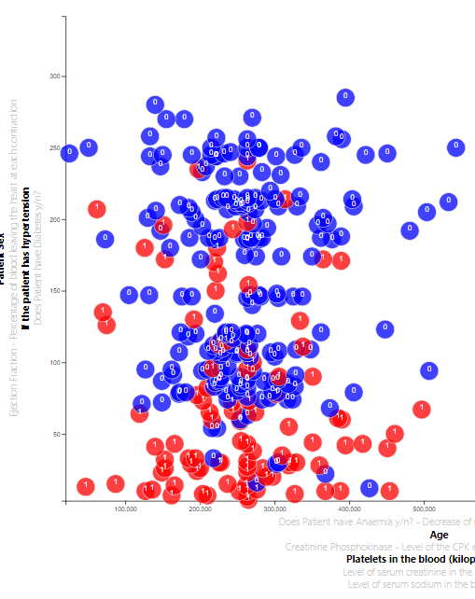
Standard Visualisations Coming Up Short
Using a D3 scatter plot it is clear that the data has some level of correlation.
However due to the nature of the plot and human limitations we are unable to draw the meaning from it.
Machine learning gives us the chance to engage with these complex relationships in a meaningful way.

Slide 8

Modelling Models in Machine Learning
Complexity in determining which models were the most useful.
Once determined turning those models into useful analysis provided some challenge.
Making the model interactive through filling out an online form and modelling that data to get a predicted result introduced further interactivity.

Slide 9
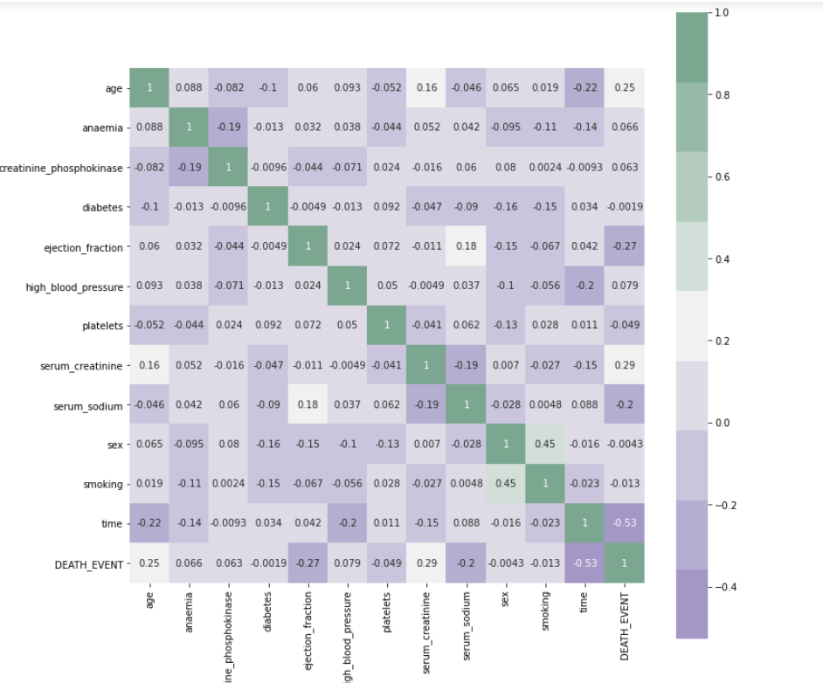
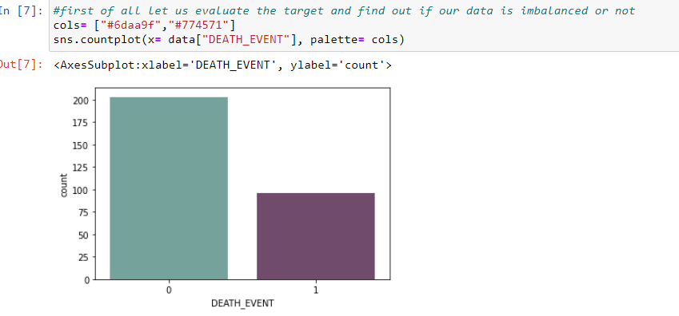
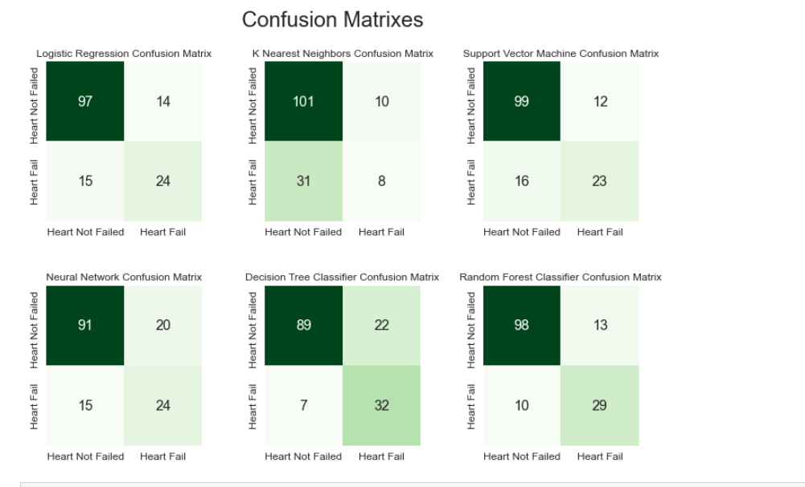
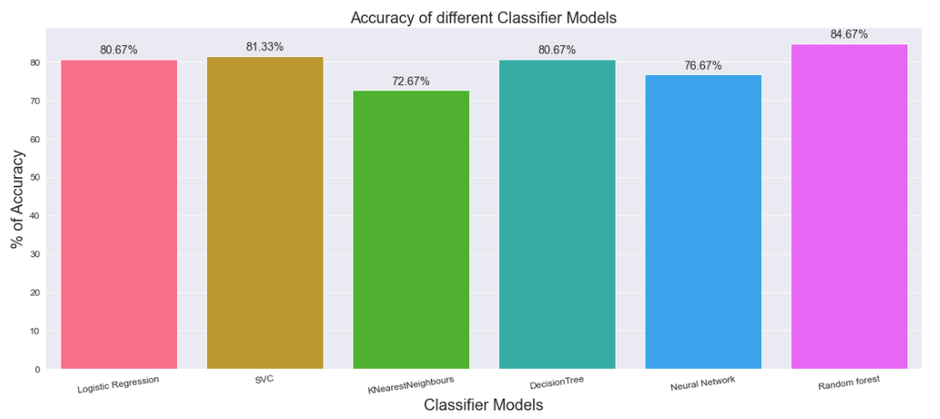

Slide 10
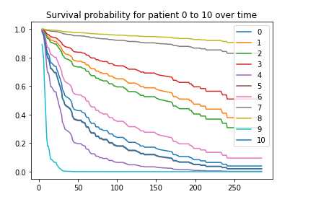
Machine Learning Continued:
Survival Analysis
cph = CoxPHFitter ()
#using Cox Proportional Hazards model fit our data
cph.fit(data, duration_col='time', event_col='DEATH_EVENT')
Where Survival analysis can be used:
Medicine
Life expectancy(e.g. Cancer)
Drug efficacy Economics
Credit risk legal
Customer retention Company
Staff turnover
Medicine => drug efficacy Economics => Credit risk Legal => Predictors of criminal recidivism Marketing => Customer retention Company can even use for predict staff turnover ! cph = CoxPHFitter() cph.fit(data, duration_col='time', event_col='DEATH_EVENT')

Slide 11

Tableau to the Rescue
We were able to integrate a Tableau Dashboard directly into our website.
Simple but visually interesting tables and graphs made the storytelling easier.

Slide 12
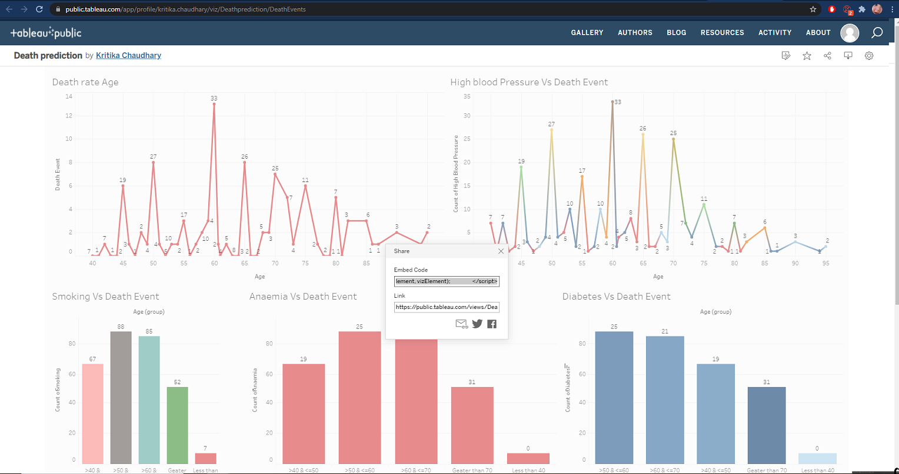
Tableau Dashboard Embedding

Slide 13

Challenges
Integrating multiple index.html pages containing D3.js
Tableau Public would not connect to Postgres Server.
Unable to plot live data of survival analysis.
Changing policies on AWS S3 Bucket so we could read the data.

Slide 14

To the Website
https://heart-disease-ml-project.herokuapp.com/

